Slide 1
Pricing “As Is” Process Workshop
May 7, 2003
5965 Coopers Ave., Mississauga

Slide 2
Agenda
Project CASPER Overview (15 min)
Workshop Introduction (15 min)
  Objectives
  Team
  Approach
Refine the high level Plan “As Is” Process (1 hr)
Walk the Process & Record (3-4 hrs)
  Problem Areas
  Rules
  Improvement Ideas
  Measurements
Alan Pinington
Alan Pinington
  “
  “
  “
All
All
  “
  “
  “
  “

Slide 3
RETAIL CYCLE
Project CASPER Overview
Analyze
Measure, Monitor & Manage
Plan
Execute
Plan
Buy
Order
Follow-Up
Move
Store
Logistics
Sell
Track
Results
Supporting Services

Slide 4
Katz Value Chain… Process model to assist in understanding the business process
Plan
Buy
Move
Sell
Market Analysis
  Research
Price Management
  Promotion Planning
Advertising
Forecasting/Demand Planning
Category Management
  Planograms
  Assortment Planning
  Category Profitability
Item Management
Inventory Management
Private Label Development
Merchandise Planning
Vendor Terms
Vendor Relations
Sourcing
Contract Management
Supplier Performance
Purchasing execution
Inventory Management Execution
Product Allocation
Order Management
Store Replenishment
Forward Buying
Collaboration (EDI, XML)
Inbound Management
  Appointment Scheduling & Sequencing
  Traffic & Transportation
  Import compliance
Warehouse Management
  Receiving
  Capacity Planning
  Pick & Pack
  Whse Replenishment
  Inventory Management
  Forecast Planning
  Vendor Collaboration
  Shipping / Shipment Consolidation
Outbound Management
  Scheduling (ASN’s)
  Freight
Customer Relationship Management
  Customer Relations
  Customer Queries
  Customer Complaints
  Refunds
Point of Sale
  Store Sales
Store Receiving
  Invoice Settlement
Store Orders
  3rd Party Order Taking
  Vendor Managed Inventory
Vendor Returns
Home Health Care
  Equipment Rental
Telesales
REPORTING, MONITORING, COST ANALYSIS AND ANALYTICS
ENTERPRISE INFRASTRUCTURE - Strategic Planning, Legal, Government Affairs, etc.
FINANCE & ADMIN - Accounting, Audit, Treasury, Human Resources, etc.
TECHNOLOGY DEVELOPMENT - IT, Telecommunications, etc.
HUMAN RESOURCE MGMT - Recruiting, training, compensations, etc.

Slide 5
Workshop Objectives
Determine the status of each of the business processes / sub-processes within the project scope so that recommendations can be tailored accordingly.
Identify problem areas.
Identify improvement opportunities.
Identify areas where the current processes / sub-processes are performing well and are candidates to keep in the future design.
Identify whether the processes / sub-processes are critical to the business, industry standard or basic
Identify potential opportunities for process / sub-process harmonization across divisions.
Identify potential opportunities to move responsibility for processes / sub-processes, e.g., to / from customers, suppliers, etc.

Slide 6
Participants
Katz
  Doreen MacKinnon Merchandise Services
  Sal Galle Category Manager
  Chris Raff Finance
  Nelia DeSouza Category Manager
  David Heald PPDM
  Brian Millier Rexall
  Wade LeCur Rexall
  Eugene Clark Herbies
  Richard Kropf Herbies
IBM
  Alan Pinnington
  Angelo Cina

Slide 7
Approach

Slide 8
During the workshop we will use a set of ground rules to assist us in focusing our discussion.
Equal vote
Listen to each other
One conversation at a time
Participation vs.. sideline-sitting
Silence means consent
"Brainstorming" vs. "Debating" vs. "Criticizing"
There are no bad ideas!
Work towards a consensus
Full-time participation by everyone
If it isn't written down, it didn't happen
Have some fun !

Slide 9
High Level Front Shop Pricing “As Is” Process
Sample
Consumer
Katz Stores
Receive Price File
Review Pricing
Change Pricing
Receive Promo Price File
DT Stores
Merchandise
Services
Setup Item
Category
Management
Manage Items
Competitive & Sensitivity Analysis
Set Price
-New
-Promo
-Reg
Finance
Analyze Profitability
Manufacturer
FMS
AC Neilson
FMS
FMS
POS
POS
Systems

Slide 10
Problem Areas
No standardization of the database. Not linked to FMS. VL project in place to help call ups from FMS. Data from spreadsheets different from that in FMS.
System is setup for one cost, one vendor, one UPC.
No regional profitability analysis.
Problem with time delay between activation and listing of new item. Timing issue also with McKesson. Their item master not in sync with ours.
Store can order item not in McKesson db because item lists are not synched. Sometime beaten to market new product because db not synched.
Supplier warehouses do not carry same items. Also, timeframes of warehouse inventory (new products) across provinces vary.
FMS does not list all items.
Pricing does not take into account banner (ie DT suggest but do not for retail price).
Which cost to put in system (ie coffee, take McKesson cost or Lumsden cost).
Competitive analysis difficult and effort intensive.
Projected volume is only after sale has occurred. Problems with tracking demand elasticity.
No link between FMS and Nexxsys systems. (item listing)
RX pricing not harmonized between banners.
Some items ordered as GM eventually make their way into the RX.
No standardized POS doesn’t not allow proper implementation of pricing methods.
Rexall pricing not std store to store, and not synched store to FMS.
Can’t keep track of out of stocks (category managers).
Multiple contracts results in multiple upcharges across banners, also effect rebates.
Manually intensive for previous point.
Reluctance to sellthrough promo items because cost is nearly promo price. Doesn’t show the backdoor money(e-coupons within POS).
Lacks visibility of invoice cost and not net. FMS lacks this tracking of variable costs. No weighted average.
Can’t reconcile merchandising data (scanned value) to the book value.
RX lacks acquisition cost, can’t reconcile variances.
DSD items cost changes weekly results in ability to set price and track margin.
Rebates given to store is based on previous sales history. If store does well this year, but did not do well last year, they still get last year’s rebate (doesn’t seem fair). Stores that aren’t on POS simply get an estimated rebate.
Stores lack visibility of rebate breakdown to forsee impact of pricing.
Long item/pricing list. Human errors with pricing feed.
Taxation issues, UPCs, info form vendor is sometimes incorrect, therefore incorrectly listed here.
Wrong UPC, pack size, min ship qty, zone pricing. (human error)
Knowledge base of errors.
Rexall doesn’t get updates to list from FMS. Store doesn’t have enough manpower to enter manually by paper.
Issues with imports from vendors. UPCs don’t match up.
Store may have received price change, but did they accept them?
Wrong UPCs provided for promo and regular so items don’t scan as setup in file.
Promo files may get corrupt in transit between HO and store. Can’t scan.

Slide 11
Rules

Slide 12
Improvement Ideas

Slide 13
Measurements

Slide 14
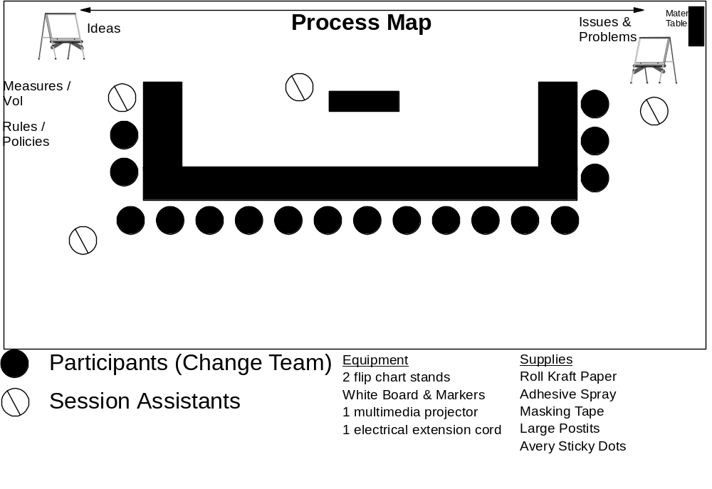
Workshop room with one long clear / clean wall, large enough to allow for catering to be in the room and easy movement

